Slide 1
Notes:
Hello everyone and welcome to the Tableau FIRST-ever developer conference

Slide 2
Tableau Analytics Extensions API
Makes ML model available to everyone!
Amir Meimand
Principal Solution Engineer,
Machine Learning and Advanced Analytics
Notes:
Thank you very much for joining me today. My name is Amir Meimand and I am very excited to talk about tableau analytics extensions api and its capability to make machine learning model available to everyone!

Slide 3
Agenda
Problem Definition
Technical Aspects:
What is tableau analytics extensions API?
How does it work?
What is the Configuration?
Use Case:
Inventory Planning
Transportation Optimization
Notes:
Before we start a quick agenda just few housekeeping items:
The goal of this session is to understand how tableau analytics extensions api can be used as deployment and utilization platform for machine learning models.
During the first part of the session I will first give you a brief introduction about myself and about the topic.
In the second part we go through some of the technical aspects of tableau analytic extension API to see how the mechanic works behind the science. Our main focused on this session will be on Tableau Integration with Python and specify for model deployment.
And in the last part I will present a real use case to see how Tableau analytic extension api put the most complex machine learning models in the hand of end users.

Slide 4

About me
Principal Solution Engineering, Strategic team
Focused on Advanced Analytics and Data Science
8+ years design and implement ML models:
Retails
e-Commerce
Healthcare
Notes:
My name is Amir Meimand I am a principal engineering solution at Tableau. I joined Tableau strategic solution team one and half year ago in the area of data science and machine learning. Prior to that I was data scientist for more than 8 years. And prior to that I was PhD student of operations research and statistics in Pennsylvania state university.
I currently am based in San Jose California. And spend my spare time on biking, camping with my wife.

Slide 5
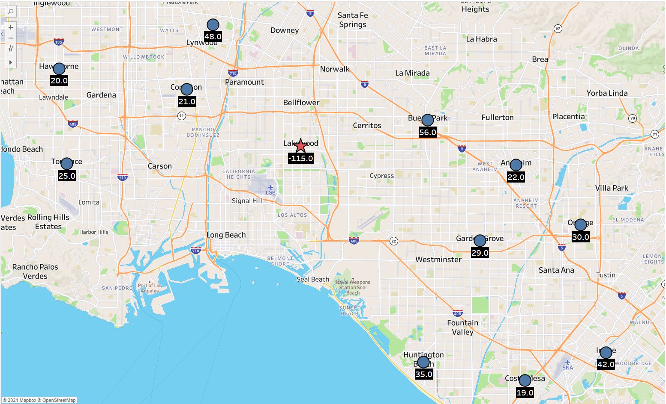
Democratize Advanced Analytics
Data Scientists tasks:
Model Building
Model deployment
Model UI Design
Notes:
One of our primary goal at Tableau and salesfore is to democratize advanced analytics. But does it mean for Data scientists?
Data scientists have a very deep technical skills and are cabal of building their own machine learning models to solve the business problems. As the result this group as uses does not need any modeling tool or platform while they need support to deliver their model and make it available to the rest of organization.
On the other hand building a platform or tool which enable non-technical people to interact and communicate with the machine learning models is usually the most time consuming and less favorite task for data scientists and developers
During this presentation I am going to demonstrate how Tableau analytic extension api can be employed to demystify this barrier. And put the most complex machine learning models in the hand of end users.
The end users regardless of their analytic background can interact with these model in an intuitive and flexible way within Tableau workflow. To adjust the input of model based on real time situation and get the corresponding result.

Slide 6
Business Problem
How to prevent inventory shortage?
Notes:
Let's first look at he business problem we are trying to solve here.
The business problem we have here is from supply chain area and specifically for inventory planning and management
In this map I visualized the location of all the retail stores I have in south California.
And for a certain day I have 115 unit shortage in one of my store in the Lakewood city. Well the good news is almost all other stores have some surplus so by transporting products from the stores with the extra inventory not only I can prevent shortage in the Lakewood city but also reduce the inventory holding cost on other stores.
Obviously non of the store individually can fulfill the Lakewood city shortage but the collection of them can.

Slide 7
Business Problem
How to prevent inventory shortage?
Notes:
On of my options might be travel to the four stores in the west part to get 115 units.

Slide 8
Business Problem
How to prevent inventory shortage?
Notes:
Or I can transport products from these three stores

Slide 9
Business Problem
How to prevent inventory shortage?
Notes:
Or these ones..

Slide 10
Business Problem
How to prevent inventory shortage?
Notes:
Or these ones!

Slide 11
Business Problem
How to prevent inventory shortage?
And
minimize transportation cost/time?
Notes:
Well we can see this problem can get very complicated too quickly because there are countless combination of stores which can fulfill my shortage at the lakewood.
So the question is which cities should I travel too to get total inventory of 115 units and also minimize my total transpiration cost or time?
From analytical perspective this is a variation of vehicle routing problem which is fall into optimization area and required a mathematical model which can find the best combination of cities considering their extra inventory and travel distance.
Obviosity I can ask my data science team to solve this problem and give me the final solution.

Slide 12
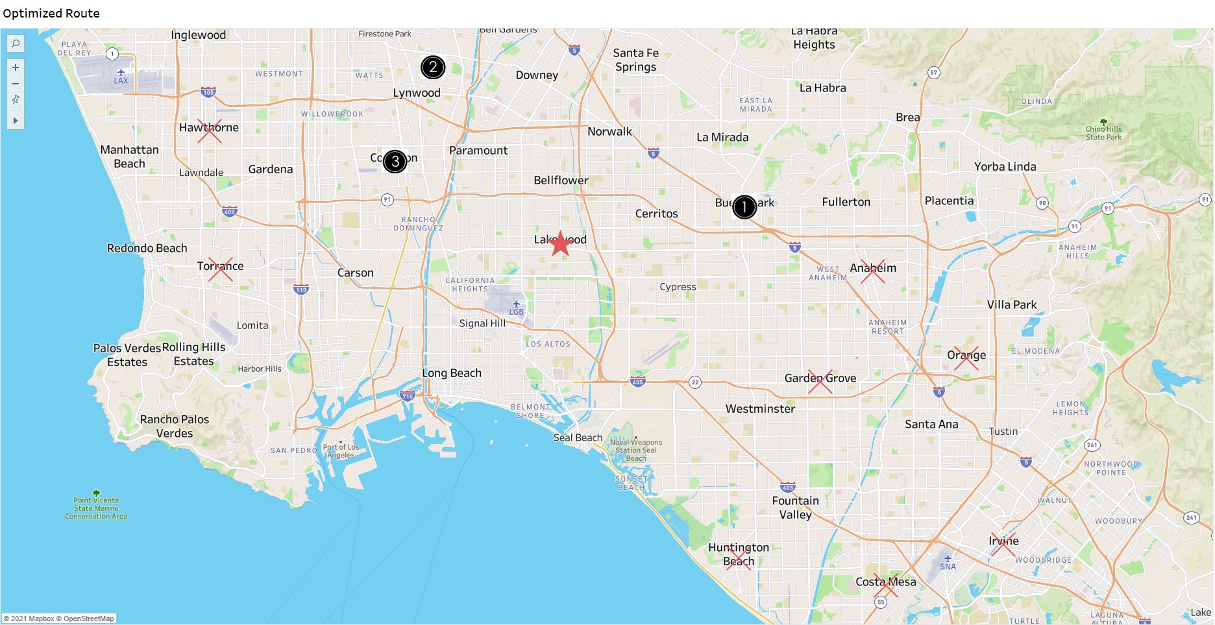
Business Problem
Static Solution
Notes:
But the main challenge is this solution needs to be dynamic and interactive. Some of the parameters my problem may change in the real time so as a decision maker I need to be able to interact with this model in the real time.

Slide 13
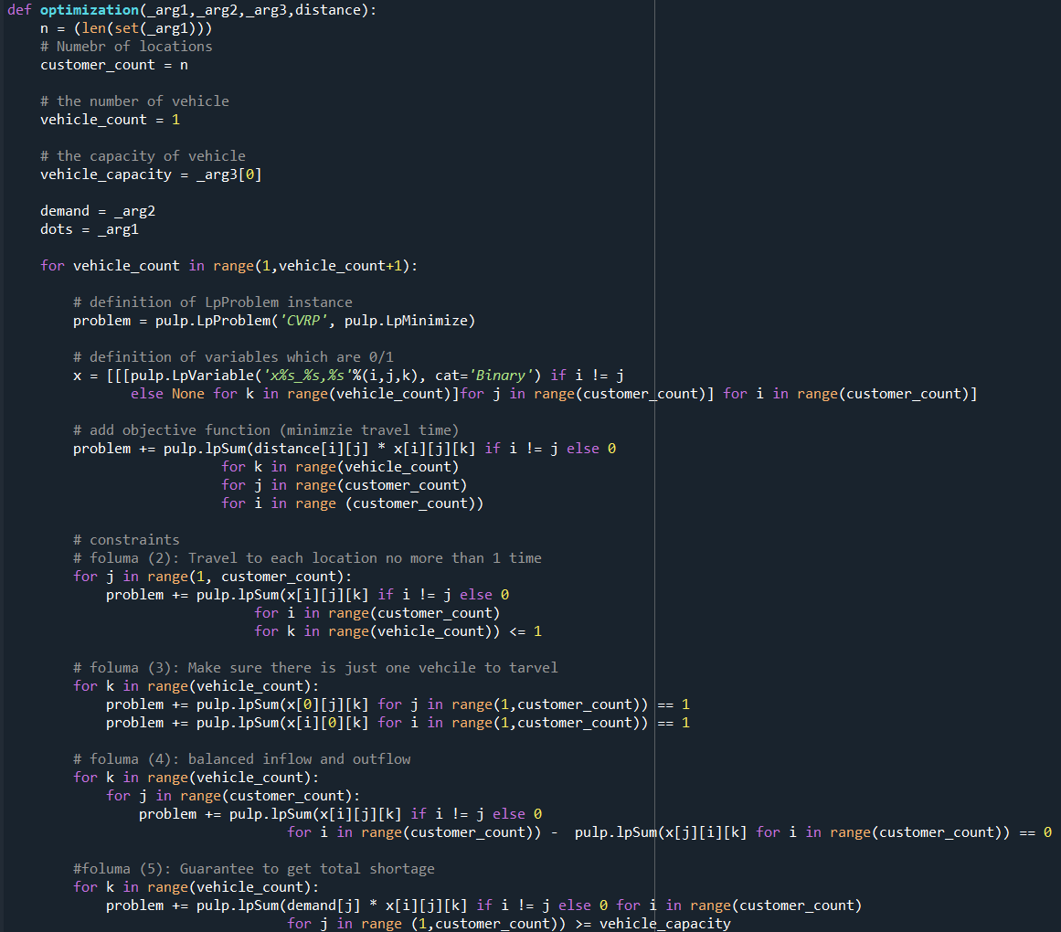

Slide 14
Business Problem
Static Solution
Interactive Solution
Notes:
For example, I may realize the reported shortage in Lakewood city was not accurate and it is 150 units. Or some of he cities are not able to provide me extra inventory anymore. Then what is the right answer to my business question?
So this the problem we are trying to solve here. And the main focuse of this session is not in building optimization or machine learning model but the foucse is how to make this model available to the end user in away that they can interact with it in the realtime.

Slide 15
Analytics Extensions API
What is it?
Notes:
All right. What is tableau analytic extensions api exactly? I am pretty sure almost everyone is familiar with or hear about dashboard extension.
Dashboard the extension extend the capabilities of Tableau dashboard by putting objects to dashboards everything from integrating more advanced analytics, natural language generation, database wrote back and many more.
With analytic extension we will bring the same extended experience to tableau calculation. (click)

Slide 16


Tableau Analytics Extensions API
Analytics Extension API – Originally developed for Python integration
Notes:
The Analytics Extensions API (Previously, known as external services) was used originally for the Python integration with Tableau which allows users to call Python functions directly from Tableau.
To the basic topology… with Tableau desktop, tableau server or tableau prep builder we can configure a connection to the analytic extension meaning python pass data out and return back in the result.
In desktop, server and online (click)

Slide 17
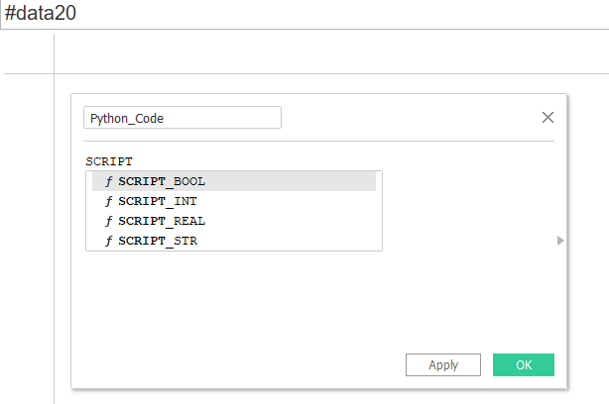

Tableau Analytics Extensions API
Analytics Extension API – Originally developed for Python integration
Received output data
Pass Python script and data
Notes:
it works through scrip calculation which has four type scrip Boolean, script integer, script real and script string and these are basically describing to tableau what to expect in the term of the type of returned data.
Although the analytic extension was originally designed for the python integration

Slide 18





Tableau Analytics Extensions API
Analytics Extension API – Beyond Python integration
Scripting Language
Notes:
Today this API has been expanded to make it more generalizable to any external analytics engine.
Basically, It makes it possible to extend tableau calculations which can communicate with almost any analytic engine by receive data from tableau and also return it back in the Realtime.
It can be interrogation with any scripting language such as R, Matlab, Java, etc.

Slide 19






Tableau Analytics Extensions API
Analytics Extension API – Beyond Python integration
Scripting Language
AutoML
Platform
Notes:
Or integration with many data science platform such as Amazon SageMaker, Salesforce ED, Data Robot, any many more.

Slide 20
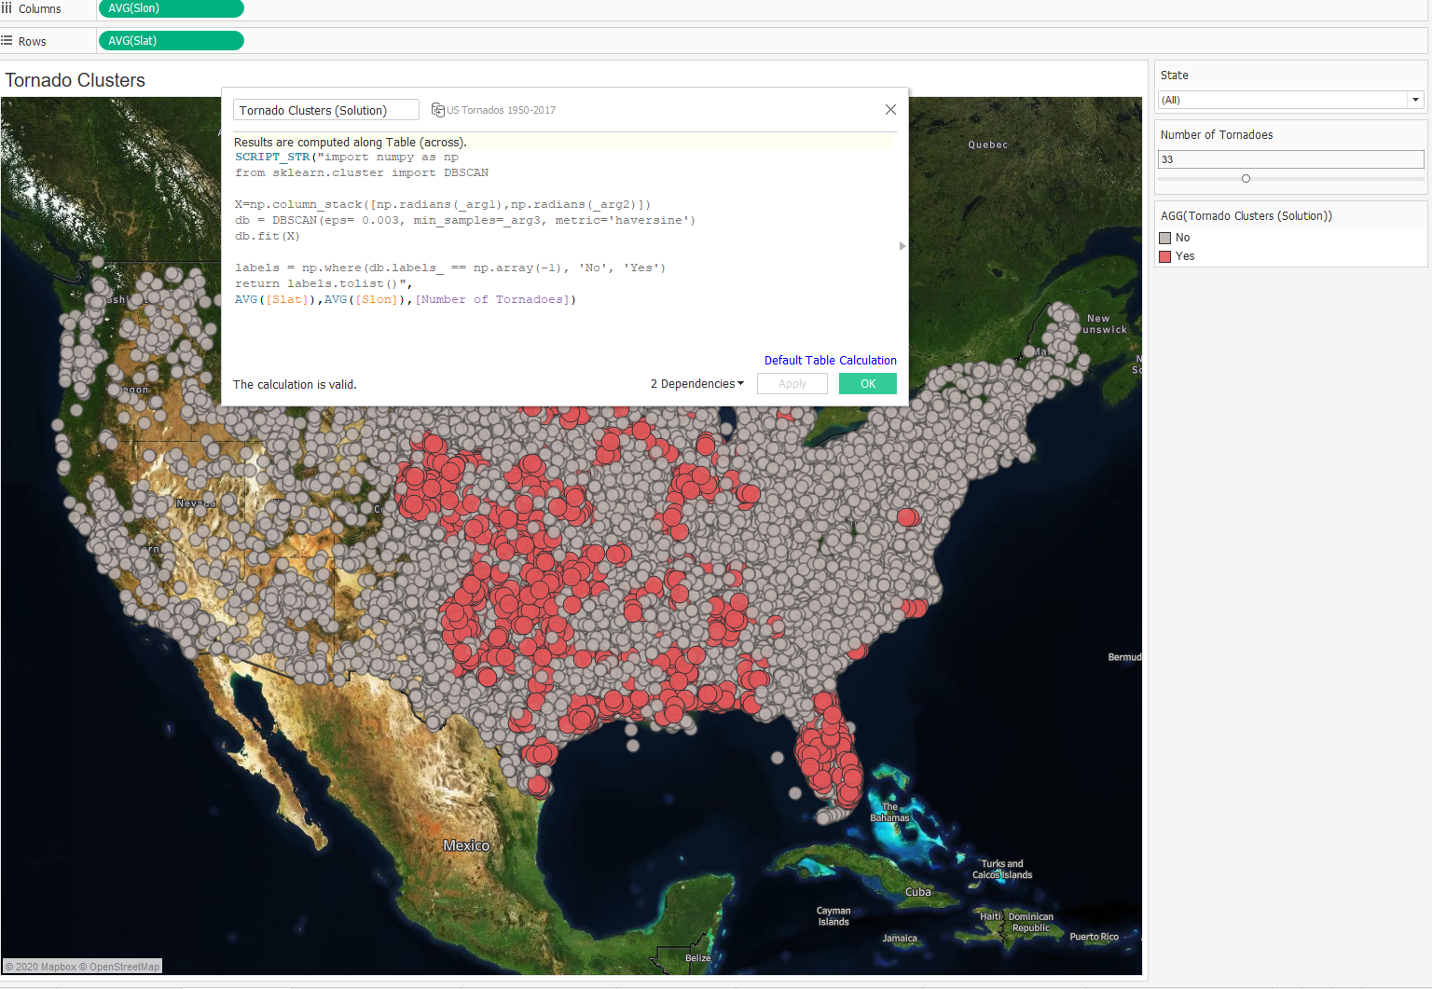
Tableau Analytics Extensions API
Notes:
in this workbook I am running python code to cluster my data point with DBSCAN clustering method from sklearn library of python to identify the cluster of tornado around the united states.

Slide 21
Tableau Analytics Extensions API
Notes:
In this example (click) I used scrip_string because my output data type has string format indicating if there is a meaningful cluster or not.

Slide 22
Tableau Analytics Extensions API
Notes:
I am also passing data from the viz (click) which is the lat and long of tornado as well as a hyper parameter for the clustering algorithm which indicate the minimum number of tornado in each cluster. Then the code will run dynamically as a tableau calculate field.
The real power of this integration is the fact that I can change what is fed into the code dynamically by applying different filters or even changing some of the hyper parameters and get the immediate result. (click)

Slide 23



Supporting Data Scientists
Model deployment is a major obstacle
Building custom UI for visualization is 10x cost and 10 maintenance
Data Scientist
Viz / UI
End Users
Notes:
In most of the organization Data scientists are working in the lap to build the machine learning or analytical models. After building the model obviously it can not live in the lab for ever and need to get out and be available to the rest of organization so decision makers and end users an benefit from it. And this is the most challenging part for data scientists because they not only need to build a model but also deploying it at the enterprise level which is one the major obstacle. Even deploying the model is not end of the story since end users need a custom UI to be able to interact with this model to understand it and ultimacy use it for decision making. And building custom UI for Data scientist is very cost and time consuming. The primary reason is the act that all users can not use the same UI, they need a UI customized for their specific situation which required a continues flow if UI request from end user to data science team. So as you see in this scenario data scientist spend most of their time in building custom UI for end user and less time on model building.

Slide 24




Supporting Data Scientists
Analytics Extensions API
Tableau
Easy to use for model deployment
On-demand report/UI with Tableau
Data Scientist
End Users
Notes:
In most of the organization Data scientists are working in the lap to build the machine learning or analytical models. After building the model obviously it can not live in the lab for ever and need to get out and be available to the rest of organization so decision makers and end users an benefit from it. And this is the most challenging part for data scientists because they not only need to build a model but also deploying it at the enterprise level which is one the major obstacle. Even deploying the model is not end of the story since end users need a custom UI to be able to interact with this model to understand it and ultimacy use it for decision making. And building custom UI for Data scientist is very cost and time consuming. The primary reason is the act that all users can not use the same UI, they need a UI customized for their specific situation which required a continues flow if UI request from end user to data science team. So as you see in this scenario data scientist spend most of their time in building custom UI for end user and less time on model building.

Slide 25
Analytics Extensions API (TabPy)
Configuration
Notes:
All right. Now lets talk about Analytics extension api configuration

Slide 26
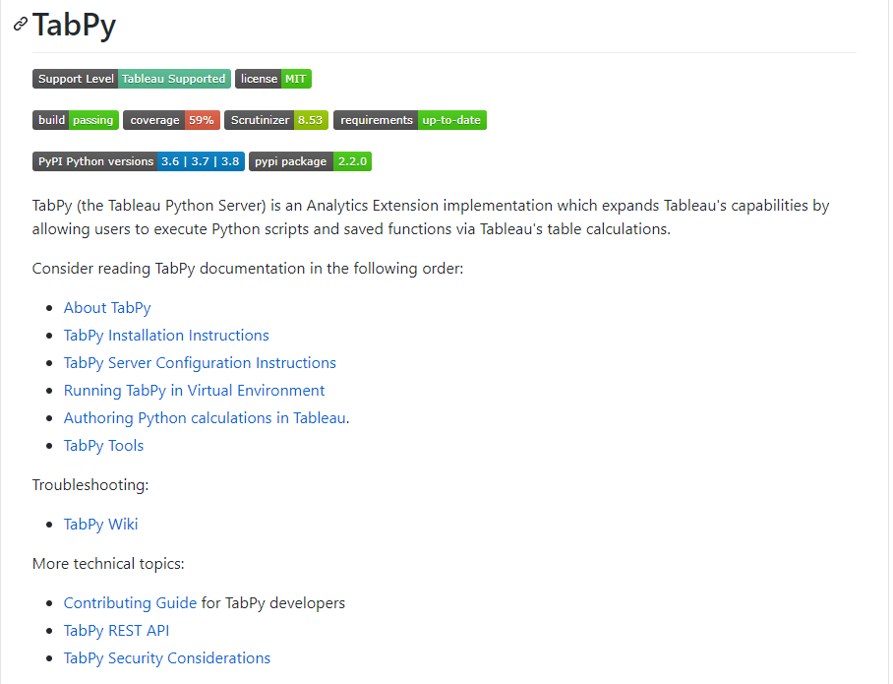
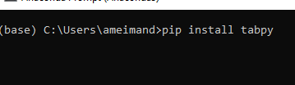
Tableau Analytics Extensions API (TabPy)
Tableau Integration with Python
Install TabPy

Slide 27
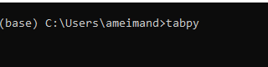
Tableau Analytics Extensions API (TabPy)
Tableau Integration with Python
Install TabPy
Run TabPy

Slide 28
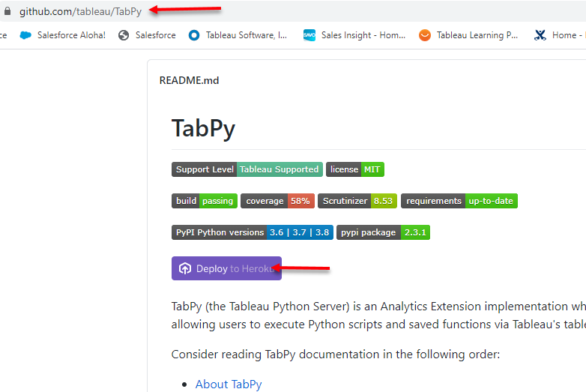
Tableau Analytics Extensions API (TabPy)
Sample Mini Project: https://lnkd.in/gYwEgdW

Slide 29
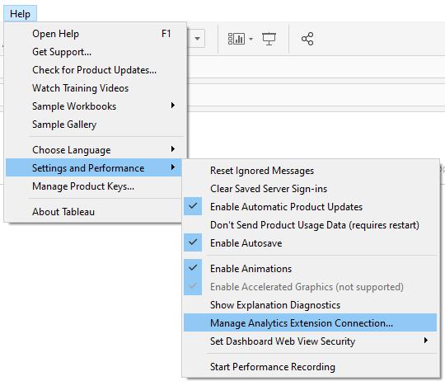
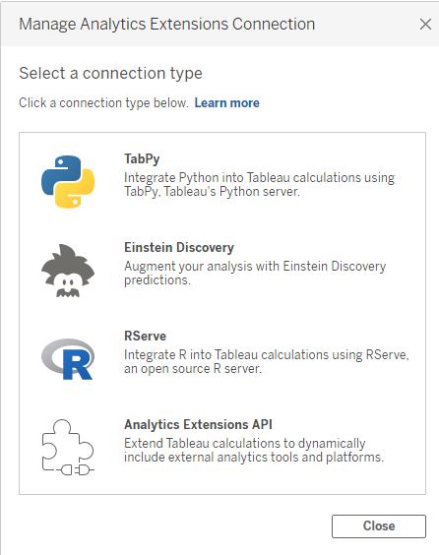
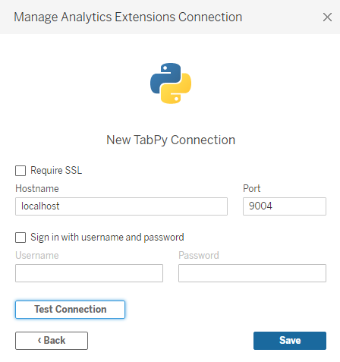
Tableau Desktop Config

Slide 30
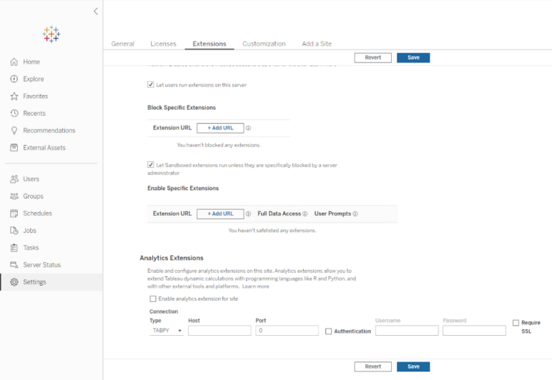
Tableau Server/Online Config

Slide 31
Analytics Extensions API
Use Case (Live!)

Slide 32


Summary
Data Scientist
Viz / UI
End Users
Model Deployment Platform
On-Demand Analytic Report
Realtime Interaction
Analytics Extensions API
Tableau
Data Scientist
End Users

Slide 33



ameimand@tableau.com Amir Meimand AmirMK
Get in touch!

